Slide 1
Lab 5: Testing
Vu Tuan Hai

Slide 2
Week | Topic | Homework
1 | Overview about the workspace of a software engineer | Project plan Setup workspace
2 | Analysis | Usecase diagram Sequence diagram
3 | Design | Class diagram Database diagram UI / UX prototype
4 | Implement | N/A (coding)
5 | Testing | N/A (coding)
6 | Evaluation the project | Complete project

Slide 3
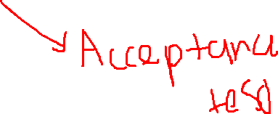
Testing
There are many type of testing, so today I will only demo manual test, automation test (unit test – integration test)
Unit test
Integrated test
Unit test
System test
Unit test
Integrated test
Unit test

Slide 4
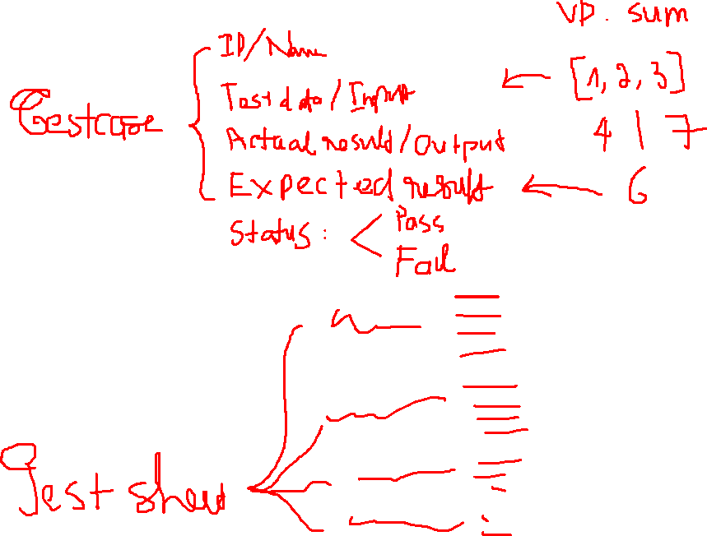

Slide 5
Manual test
Test and write results on the test sheet.
Test all test cases again if the source code has an update
Demo manual test

Slide 6
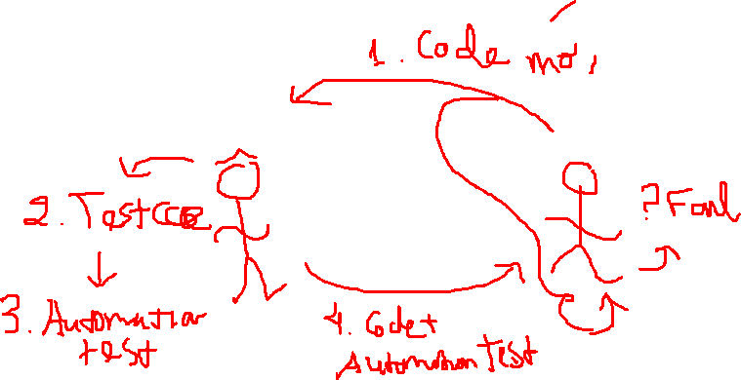
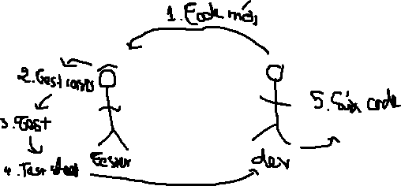

Slide 7
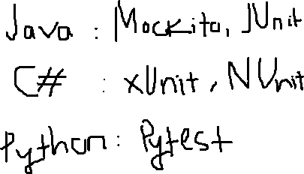
Automation test
Use another library to assert the expected result with the actual result
Write one time, run many times
Demo automation test

Slide 8
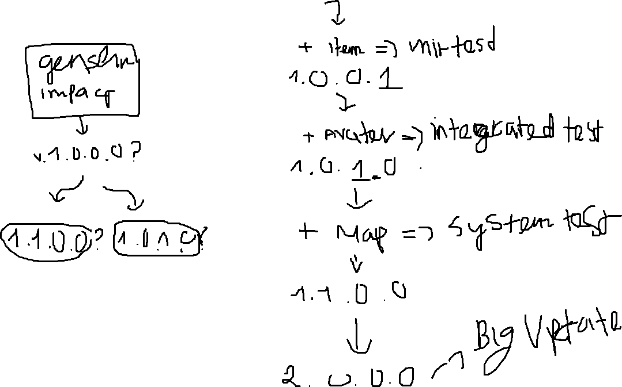

Slide 9
Question

